Slide 1




Netkathir Technologies Pvt. Ltd.
Company Presentation
Call us: +91 95855 71860
WhatsApp us: +91 94877 16814
Email us: admin@netkathir.com
info@netkathir.com
www.netkathir.com

Slide 2

About Us
Netkathir Technologies Pvt. Ltd., is a Software Development company created by professionals with 20 years of expertise knowledge in IT and Auditing, along with experience in multiple domains.
Netkathir Technologies Pvt. Ltd., is also have “Business Process Management” software with inhouse developed framework which can be easily customized for all type of companies including Corporates, Private and Public Sectors.
Netkathir Technologies Pvt. Ltd., professionals are well trained with multiple technological skills and carry both functional and technological expertise.
Services Offered:
Technology Solution for “Business Process Management”.
Application Development and Solutions.
Web Design, Maintenance and Hosting.
Software Products and Support.
Enhancement of existing applications or integrations.
info@netkathir.com
www.netkathir.com

Slide 3
Products
01 | Netkathir ERP - Features
Cloud based application developed by Netkathir Technologies. Provids Multiple ERP solutions in different sectors including manufacturing sectors. This helps manufacturers, consultants and its administration offices handle complex business functionality in the most flexible and easy manner. An ERP System allows for you to run your business at a lower cost. Lower management and operational costs - Decision makers can monitor operations and production in real-time. Data is available in a centralized location with complete visibility across all functionalities. Improved efficiency - Improves work efficiency, accountability and save time Handle enquiries from different sales channels. Lower operational costs - Reduce administrative and operational costs through automated processes. This allows users to pro-actively manage operations and prevent delays. Table view handles 10 000 items with ease
info@netkathir.com
www.netkathir.com

Slide 4
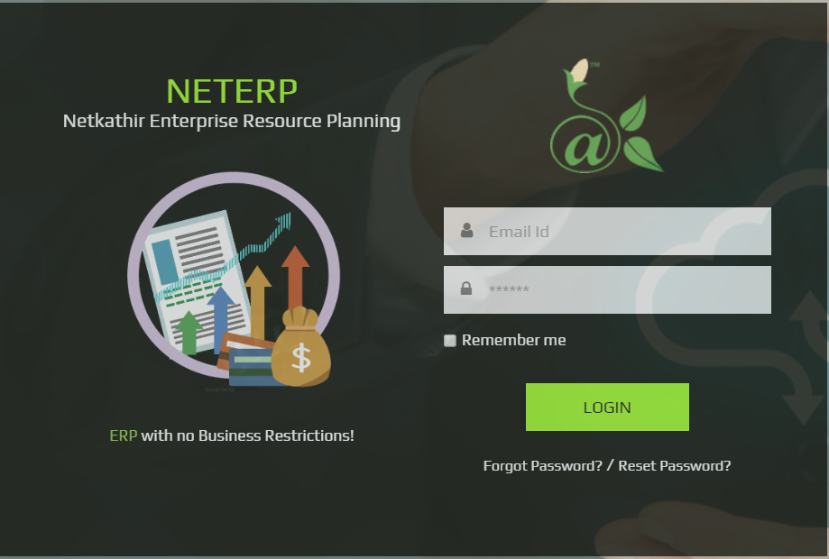
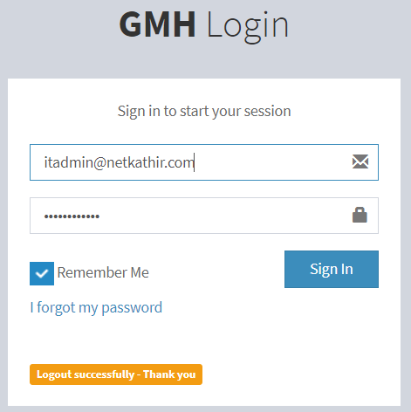
Product Features
01 | Netkathir ERP - Features
CRM. Company Asset Management. HR Management. Payroll Management. Job Management. Bill of Materials with automated Purchase list generation. Supplier quotation Comparison and Purchase Order Management. Material Inward Management with QC and Debit note generation. Inventory Management. Scrap Inventory Management. Reporting. Billing and Invoice. Delivery Challan management.
info@netkathir.com
www.netkathir.com

Slide 5


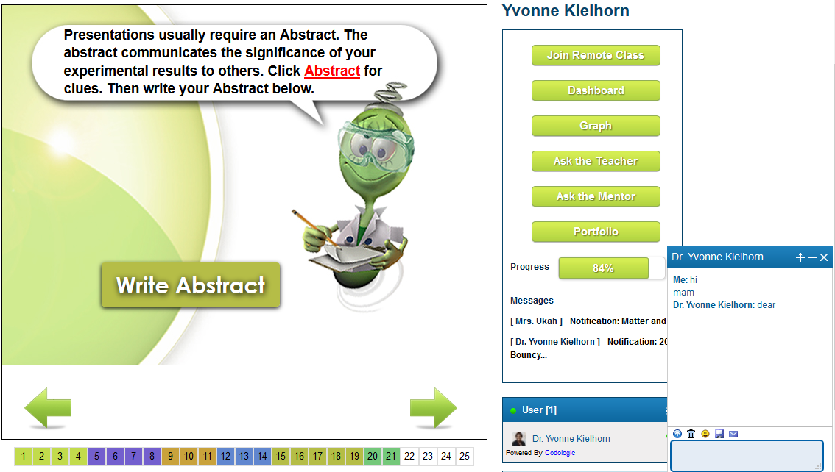
Partner Product
eLearning Platform to teach students offline or online. This is more focused for Schools to use the platform to build the module and teach students through online with same level of teaching for all the students. This platform has in-build features of white board class rooms, interactive simulations and grading students. Additional features - Remote class, Student Management, Grading and Library
info@netkathir.com
www.netkathir.com

Slide 6
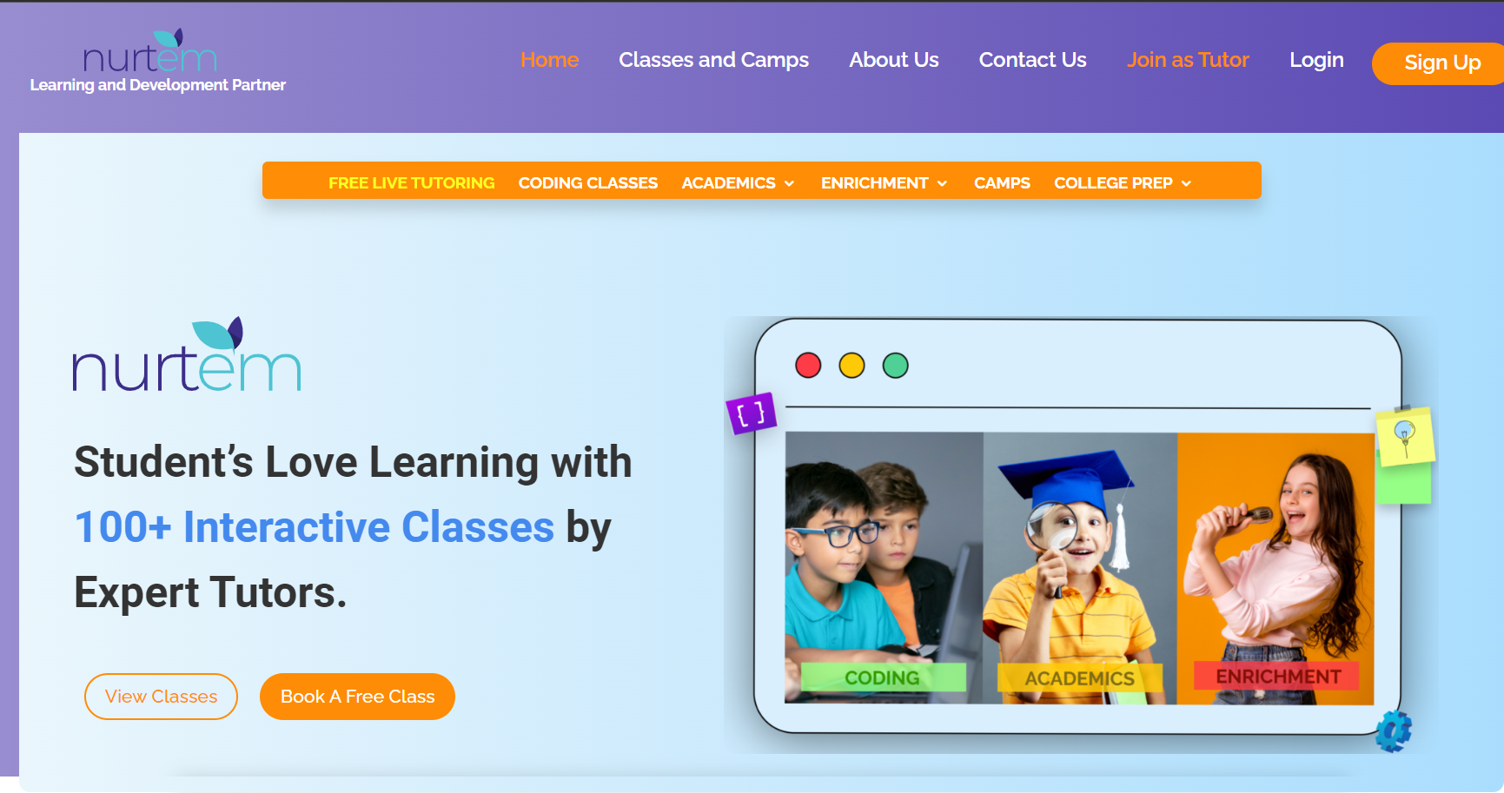
Client Products
NURTEM
eLearning Platform to teach students online. This is more focused for Tutors to use the platform to build the module and teach students through online. Any type of teaching can be done using this platform including Yoga, Music etc.,
info@netkathir.com
www.netkathir.com

Slide 7
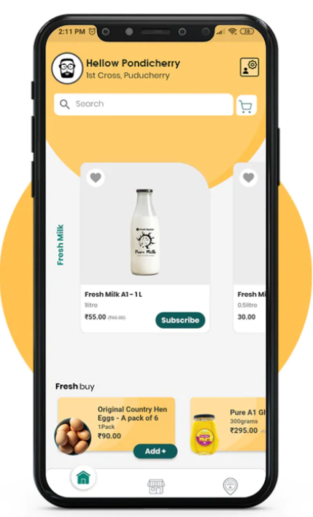
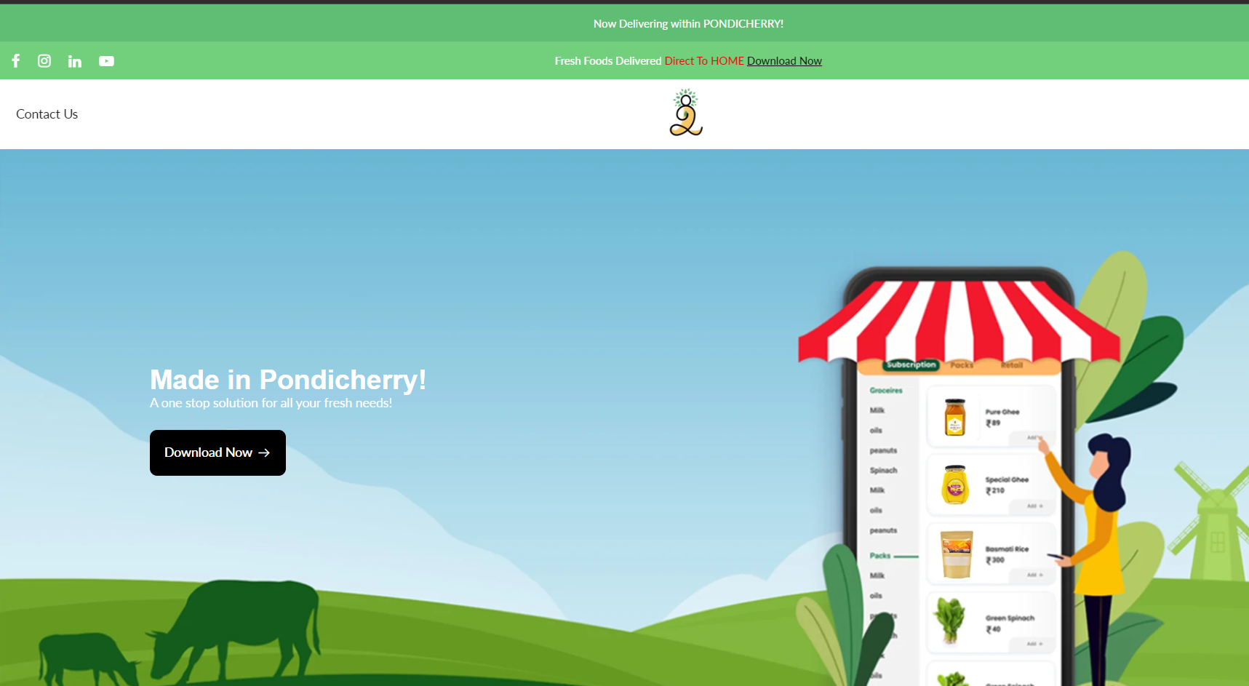
Client Products
FRESH SQUARE
eCommerce App – end to end solution of managing the B2C business. The world class features are available in the app Subscription management is the highlighted feature in this app Netkathir is a technology partner to build the app
info@netkathir.com
www.netkathir.com

Slide 8
Technology stack
Technology Stack
Client-side : HTML, CSS, BOOTSTRAP, JQUERY, JAVASCRIPT, AJAX, REACT
Database : MySQL, MSSQL,MONGODB, CASSANDRA(for BigData Applications)
ServerSide : PHP, ASP .NET(MVC), VB.NET, JAVA, Node js
Mobile Technologies : Native Android(Java, Kotlin) / Native Ios(Swift) / Cross Platform Flutter (Dart) - Supports Android & IOS
Linux Administration : Ansible for Application Deployment + Configuration Management + Continuous Delivery.
Cloud Services : AWS - Elastic bean stack , EC2, RDS, Light Sail, S3, Route 53 and any other AWS services
CMS : Wordpress, Opencart, Prestashop, Elgg
Reporting Tools : Crystal report, SSRS report, Telerik controls.
Designing/Animation Side : Photoshop
Test Automation : Java – Groovy, Selenium with Katalon tool.
info@netkathir.com
www.netkathir.com

Slide 9
Specific ASK
Specific Ask:
Connect to Companies who are willing to automate their process with considerable budget allocated for software implementation.
Connect to startup companies who wants to start the business with software dependent like mobile app and to implement world class app as their vision.
Connect to companies who wants technology partner to improve their business using software.
info@netkathir.com
www.netkathir.com

Slide 10
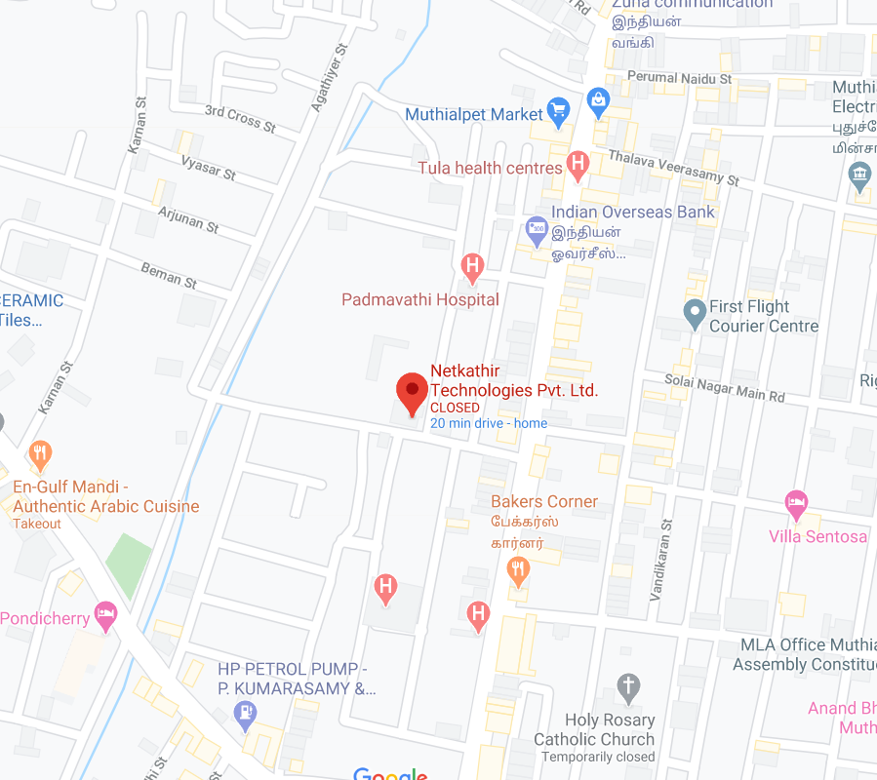
Contact Us
Address:
Netkathir Technologies Pvt. Ltd.
No. 10, Maria Tower, 1st Floor,
Vallavari Street, Muthialpet.
Puducherry - 605003, India.
Office: +91 413 2972414
Mobile: +91 95855 71860
WhatsApp: +91 94877 16814
info@netkathir.com
www.netkathir.com
info@netkathir.com
www.netkathir.com

Slide 11
Thank You
info@netkathir.com
www.netkathir.com

